Slide 1
Welcome
Cyber Defense Organization

Slide 2
Collegiate Cyber Defense Competition
We recently went…
1st time ever at regionals
Placed 5th out of 10th teams

Slide 3
Competition TIME!
Who is interested in being on a competition team?
UBNetDef is on April 28th, 2018 from 9AM to 5PM
Hosted at the University at Buffalo.
We are sending TWO teams! They will consist of 6 members each.

Slide 4
Also upcoming:
Eboard meeting Friday at 11am BB121
Board applications are coming soon!

Slide 5
Student Elections
Guest Dillion Asmus
Business Management Academic Seat -- Student Association
Email: dasmus@albany.edu

Slide 6
5-Minute Plan
Philosophy & Windows Example
By Liam

Slide 7
What is a 5-minute plan?

Slide 8
5-Minute Plan
This is our plan of attack as soon as you walk on to the scene of an incident.
(In this case the competition).
While it can be longer than 5 minutes, it generally includes context-agnostic steps you want to take.

Slide 9
What does it actually look like?
A fancy checklist, often separated into modules/chunks.

Slide 10
Creating a checklist
Have a factsheet you can fill out
Be as specific as possible
Bold the critical parts
Don’t include anything you have never tried
Don’t shorthand anything (funny story in Qualifier)
Print it a little larger than you need
Use the full path
Use a good template that can automatically create a table of contents

Slide 11
Testing a checklist
Realistic way:
Realize that you have run out of time to build a list
Throw together something at the last minute
Travel in a car for 5 hours
Get to a cold hotel room
Barely sleep. (Bonus points if you get an allergic reaction).
Wake up at 6:30am
Feel too anxious/sick/nervous to eat
Listen to a boring person explain the importance of cyber
Lose the will to live
Run to your room
Not even have your coat off before scoring starts
Begin your checklist
Easy way:
Don’t look at it for a few days
Have a friend set up an environment
Go through your list step by step

Slide 12

My Steps:
Phase 1:
Phase 2:
Phase 1:
Initial Access
New Admin User
Backups
Setting Auditing
General Hardening steps
Downloading tools
Phase 2:
Service upkeep
Firefighting
Threat hunting

Slide 13

Setting up Auditing
Why is this so important?
It lets you get the “heartbeat” of your device
Staring at the desktop gives you nothing
Logs are like a cellar of fine wine
It’s hard to have too much
And it takes time for them to be valuable

Slide 14
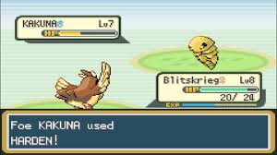
General Hardening Steps
Mitigating Common Vectors
Preventing connection on certain ports
Eliminating unnecessary functionality
Turning off print spooling, or RDP
Setting Up Proactive Measures
Vulnerability scanners (Microsoft Baseline Security Scanner)
Antivirus (Windows Defender)

Slide 15
Workshop Plan
Cyberdeforg1
Auditing
Enable logging of Logins, Privilege use, and policy changes
Hardening
Disable Guest Account
Set machine lockout threshold
Enable password complexity requirements
Disable services: print spooler, Remote Desktop
Look for weird Firewall rules
Block port 5968 (Remote execution)

Slide 16
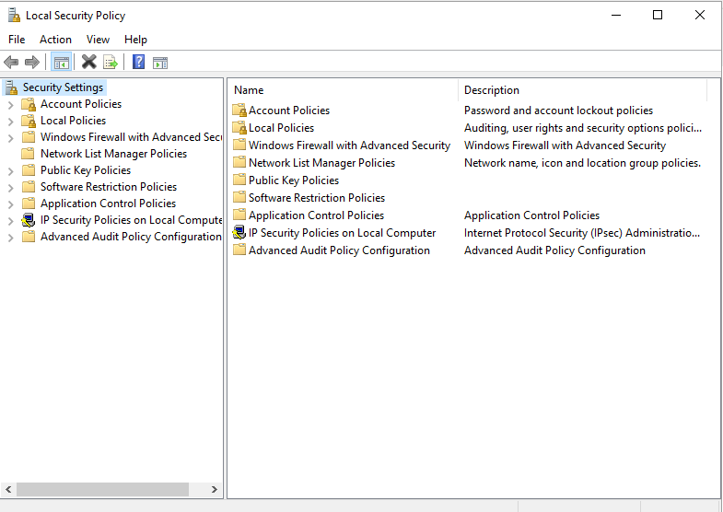
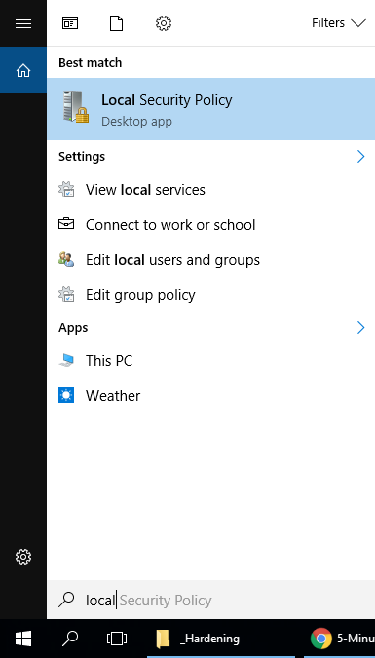

Slide 17
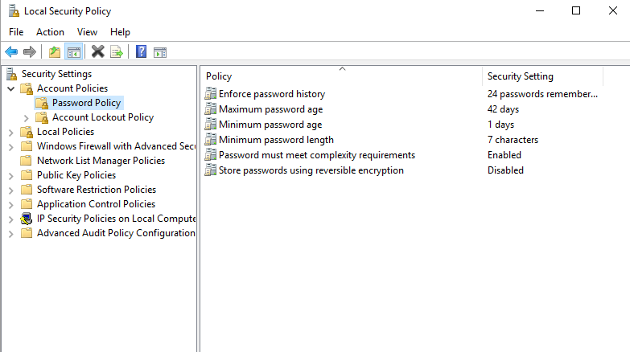

Slide 18
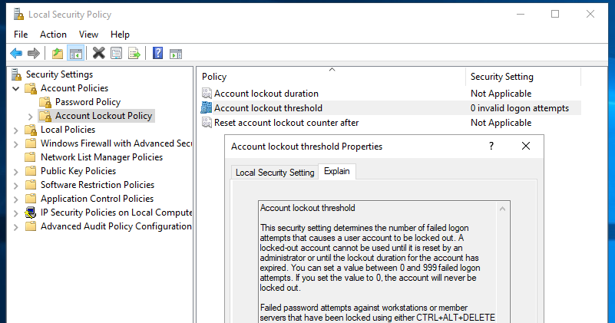

Slide 19
Now Try:
Auditing
Enable logging of Logins, Privilege use, and policy changes
Hardening
Disable Guest Account
Set machine lockout threshold
Enable password complexity requirements
(Hint, expand all the top level options!)

Slide 20
Enable Firewall logs
Method 1: Windows Firewall GUI
Open the Advanced Firewall Management Snap-in (WF.msc)
Select the Action | Properties from the main menu
On the Domain Profile tab, click Customize under the Logging section.
Increase the file maximum size.
Turn on logging for dropped packets
Turn on logging for successful connections
Method 2 – PowerShell
Open a PowerShell window as Administrator and execute:
Set-NetFirewallProfile -name domain -LogMaxSizeKilobytes 10240 -LogAllowed true -LogBlocked true
By default your firewall will start logging to %systemroot%\system32\LogFiles\Firewall\pfirewall.log. You may like to change this to a central logging server.

Slide 21
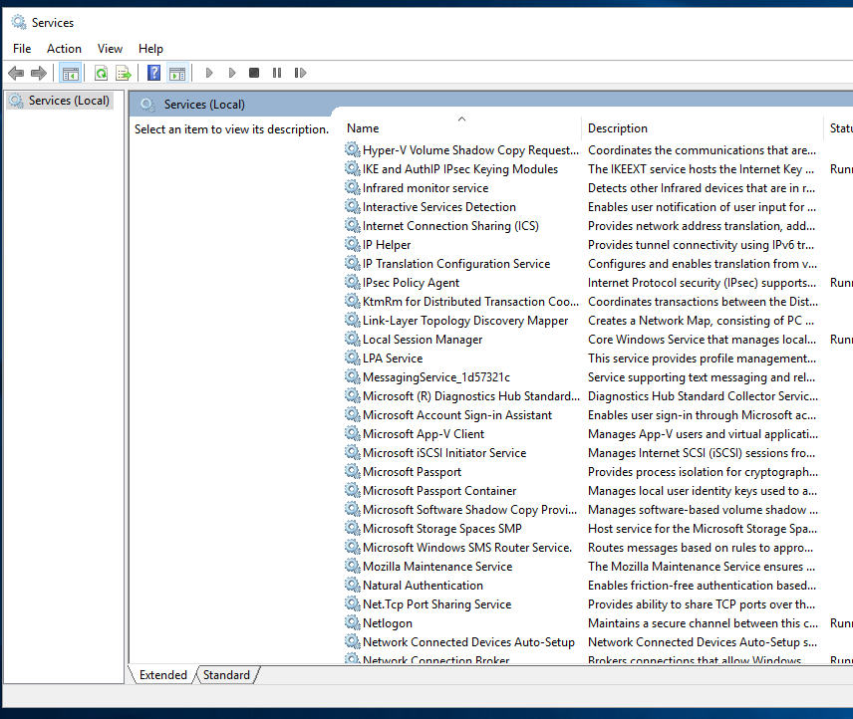
Find and disable: print spooler & remote desktop

Slide 22
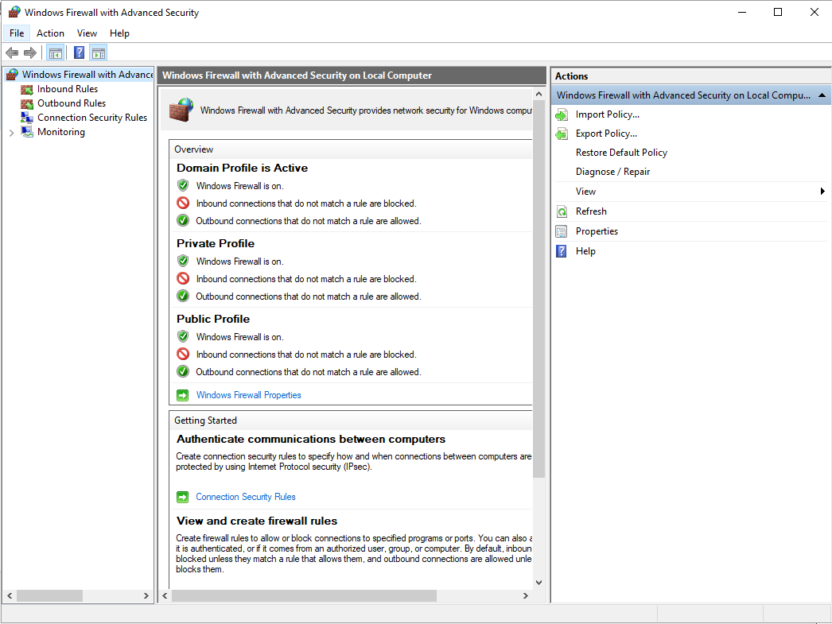
Look for weird rules, and remove them.
Create a new inbound rule, block port 5968.

Slide 23
Finally:
Remember those audit policies?
They *should* have been logging all the actions you have been taking!
They are all in Event Viewer!

Slide 24
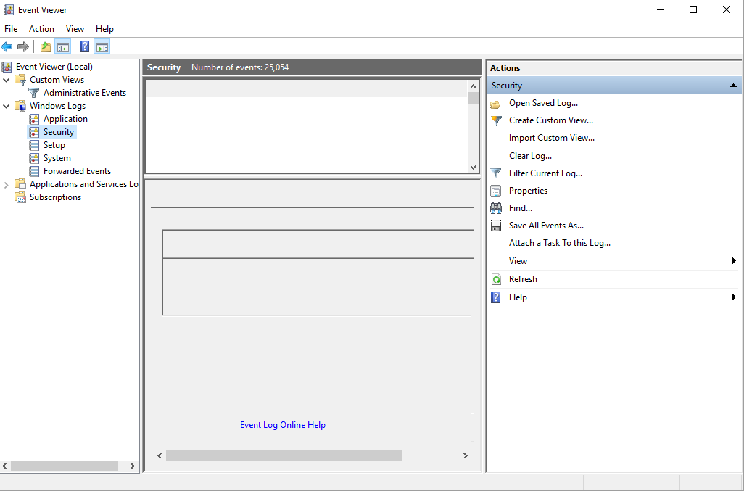

Slide 25
Things we did not cover
Active Directory User, Group, Computer and OU Management
Creating a new Administrator
Creation, implementation, and testing of Group Policy
Monitoring, Testing, Backing Up, and Managing DNS
Monitoring, Testing, Backing Up, and Managing DHCP
Understanding sysinternal tools (procmon, procexplorer, tcpview)
Running and Understanding a Microsoft Security Baseline Analyzer
Powershell

Slide 26
Follow us on Twitter! @ualbanyCDO
New logo -- Ideas? Email them to us at cyberdefenseorg@albany.edu
Whats coming up again?
UBNETDEF
Eboard meeting Friday at 11am BB121
Board applications are coming soon!

